Slide 1
Detecting Exoplanets and recovering Parameters
A short recap of my work in week 4

Slide 2
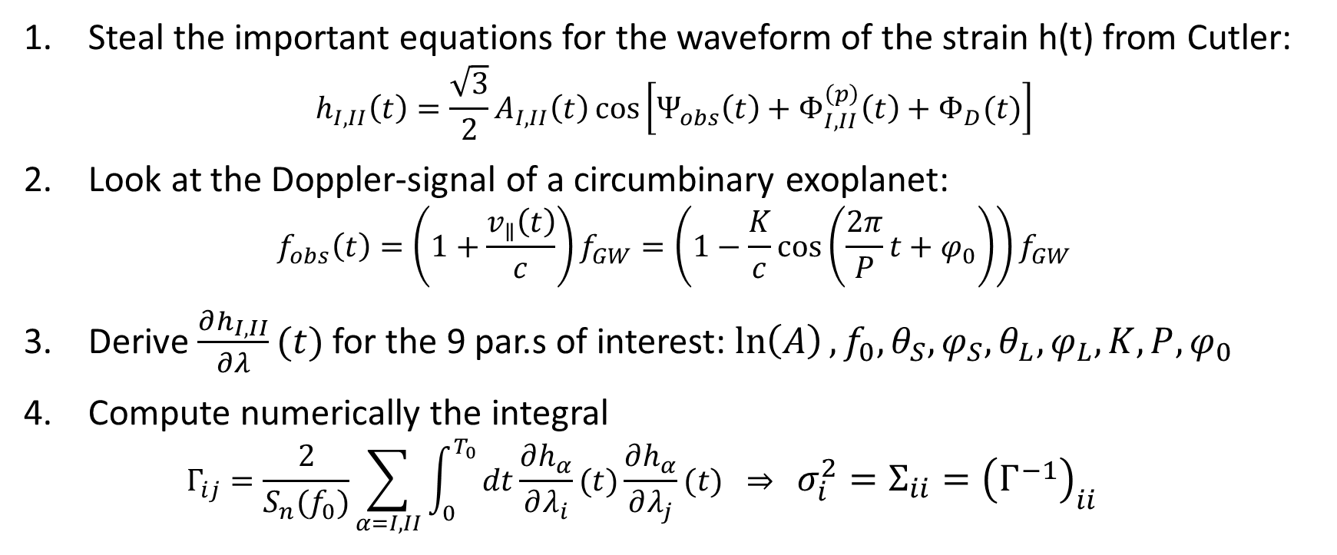
What did Tamanini and Danielski do?
Steal the important equations for the waveform of the strain h(t) from Cutler: $h_{I,II}\left(t\right)=\frac{\sqrt{3}}{2}A_{I,II}\left(t\right)\cos\left[Ψ_{obs}\left(t\right)+Φ_{I,II}^{\left(p\right)}\left(t\right)+Φ_{D}(t)\right]$
Look at the Doppler-signal of a circumbinary exoplanet: $f_{obs}\left(t\right)=\left(1+\frac{v_{∥}\left(t\right)}{c}\right)f_{GW}=\left(1−\frac{K}{c}\cos\left(\frac{2π}{P}t+φ_{0}\right)\right)f_{GW}$
Derive $\frac{∂h_{I,II}}{∂λ}(t)$ for the 9 par.s of interest: $\ln\left(A\right), f_{0},θ_{S},φ_{S},θ_{L},φ_{L},K,P,φ_{0}$
Compute numerically the integral $Γ_{ij}=\frac{2}{S_{n}(f_{0})}\sum_{α=I,II}{\int_{0}^{T_{0}}{dt\frac{∂h_{α}}{∂λ_{i}}(t)\frac{∂h_{α}}{∂λ_{j}}(t)} } ⇒ σ_{i}^{2}=Σ_{ii}={\left(Γ^{−1}\right)}_{ii}$

Slide 3
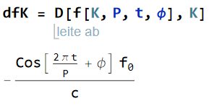
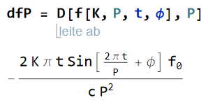
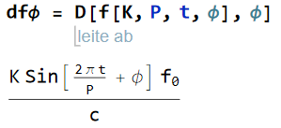
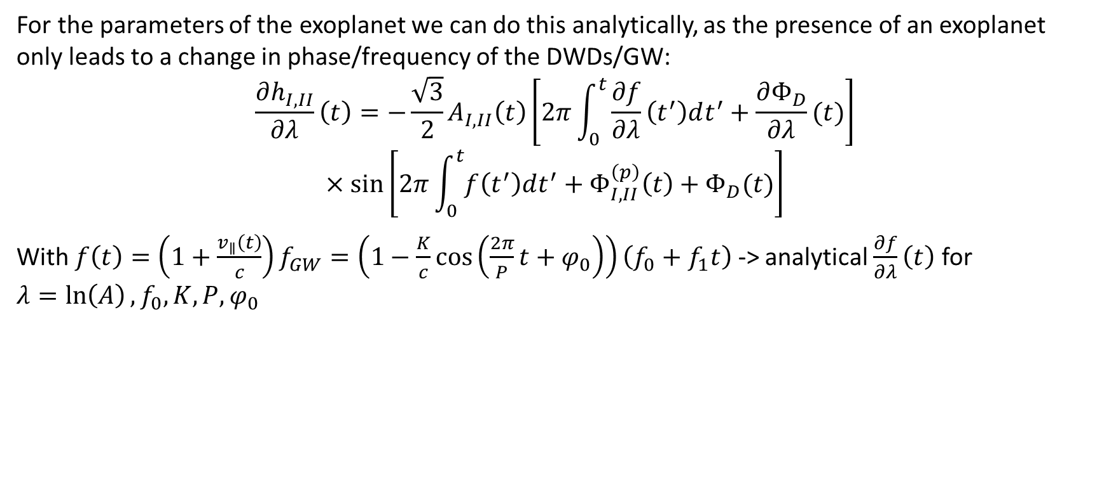
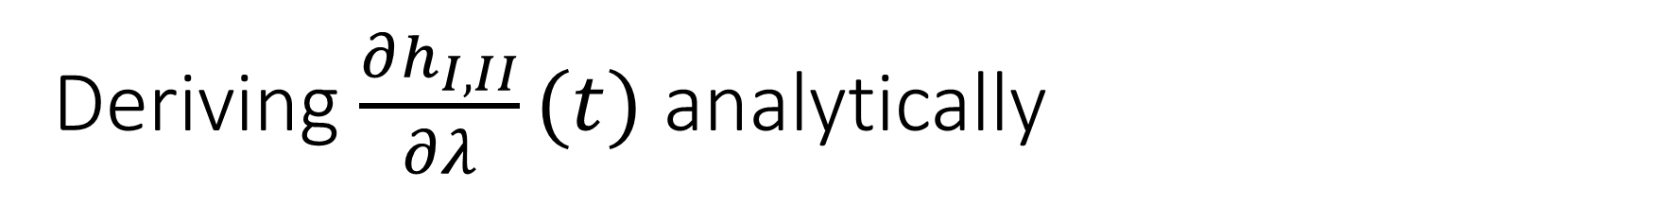
Deriving $\frac{∂h_{I,II}}{∂λ}(t)$ analytically
For the parameters of the exoplanet we can do this analytically, as the presence of an exoplanet only leads to a change in phase/frequency of the DWDs/GW:
$$\frac{∂h_{I,II}}{∂λ}\left(t\right)=−\frac{\sqrt{3}}{2}A_{I,II}\left(t\right)\left[2π\int_{0}^{t}{\frac{∂f}{∂λ}\left(t^{′}\right)dt^{′}}+\frac{∂Φ_{D}}{∂λ}(t)\right]$$
$$×\sin\left[2π\int_{0}^{t}{f\left(t^{′}\right)dt^{′}}+Φ_{I,II}^{\left(p\right)}\left(t\right)+Φ_{D}(t)\right]$$
With $f\left(t\right)=\left(1+\frac{v_{∥}\left(t\right)}{c}\right)f_{GW}=\left(1−\frac{K}{c}\cos\left(\frac{2π}{P}t+φ_{0}\right)\right)\left(f_{0}+f_{1}t\right)$ -> analytical $\frac{∂f}{∂λ}\left(t\right)$ for $λ=ln\left(A\right), f_{0}, K,P,φ_{0}$

Slide 4
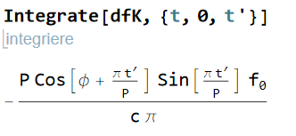
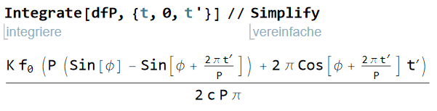
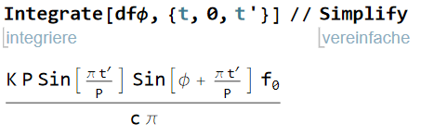
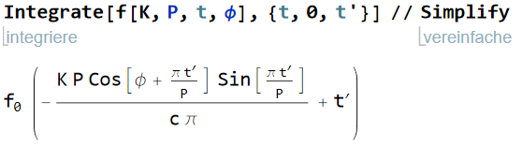

And we can also do $2π\int_{0}^{t}{\frac{∂f}{∂λ}\left(t^{′}\right)dt^{′}}$ analytically

Slide 5
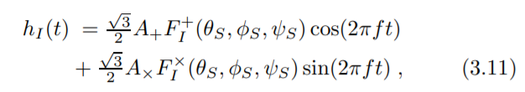
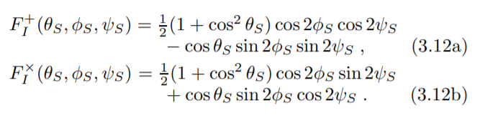
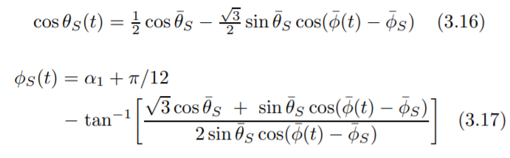
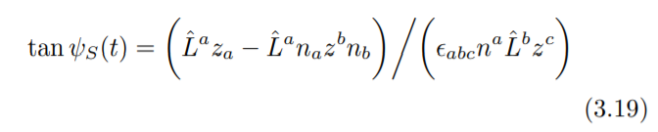
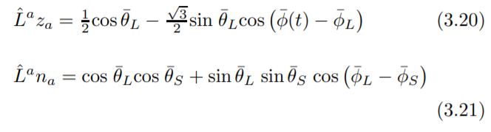
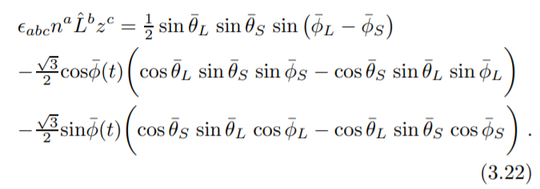
Regarding the position and angular momentum
The position and angular momentum of the binary source influences the strain non-trivially, see [3]:

Slide 6
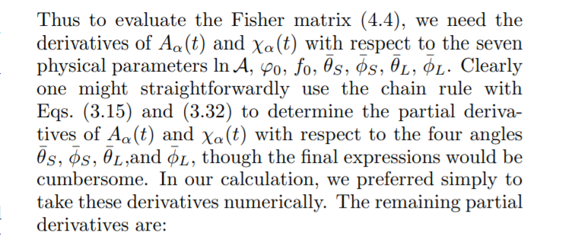
…so we do what Cutler proposes
In our case we initialise a second class instance of our class binary(position + 1e-6) and compare it via (binary(position + 1e-6) – binary(position)) / 1e-6 (same as scipy.misc.derivative)

Slide 7
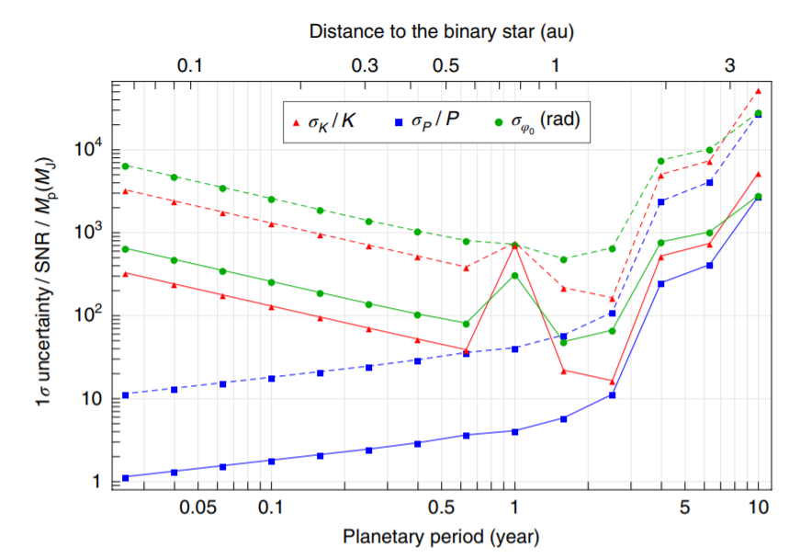
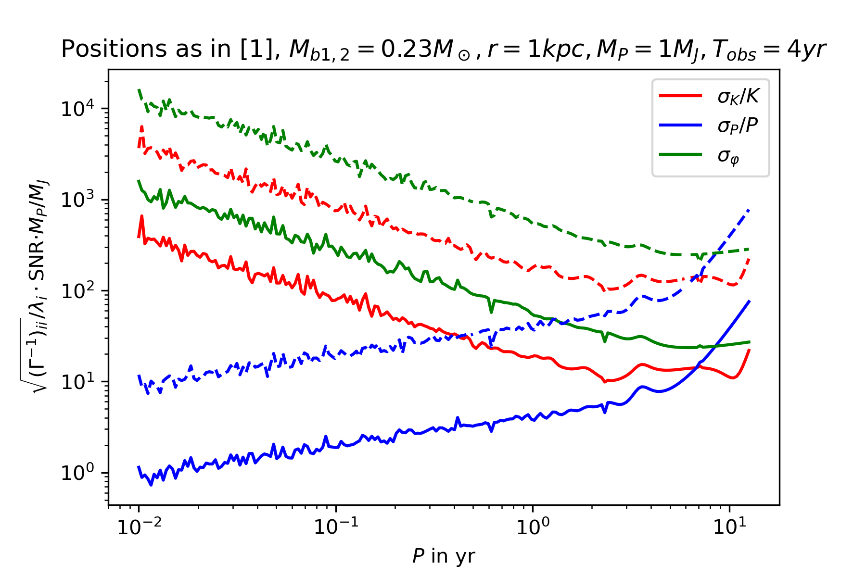
Computing the uncertainties approximately
This calculation only included the lower diagonal block of the Fisher information

Slide 8
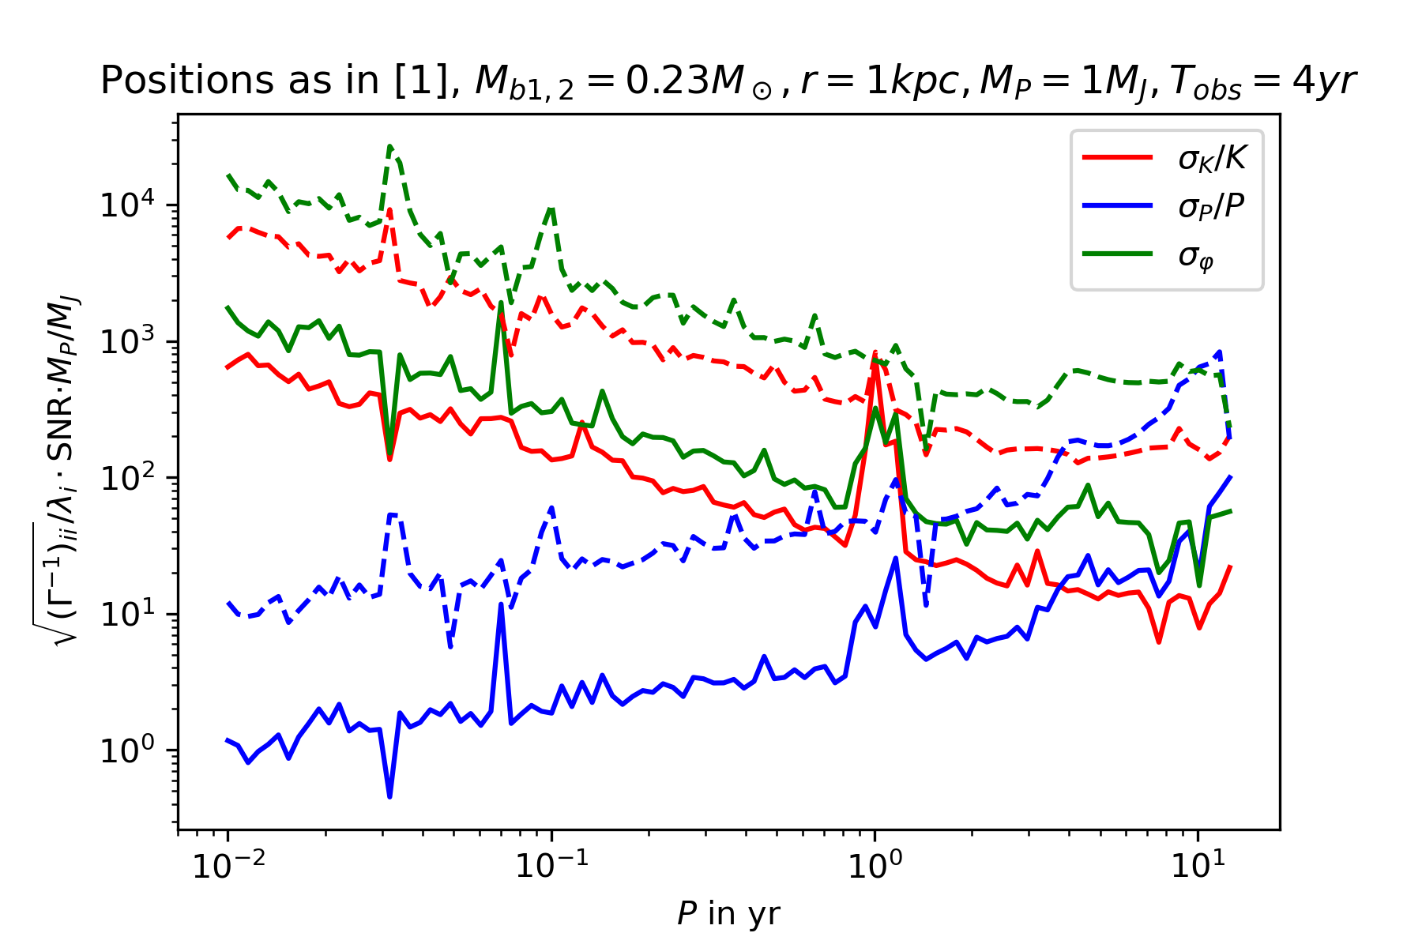
Computing the uncertainties
But we can do better by taking all relevant parameters into account -> degeneracy @ 1yr appears
Problem 1: Why is it so fluctuating? Probably: Numerical derivation, integration, inversion, but WIP
Problem 2: Where is the steep increase at P > 4 yr?

Slide 9
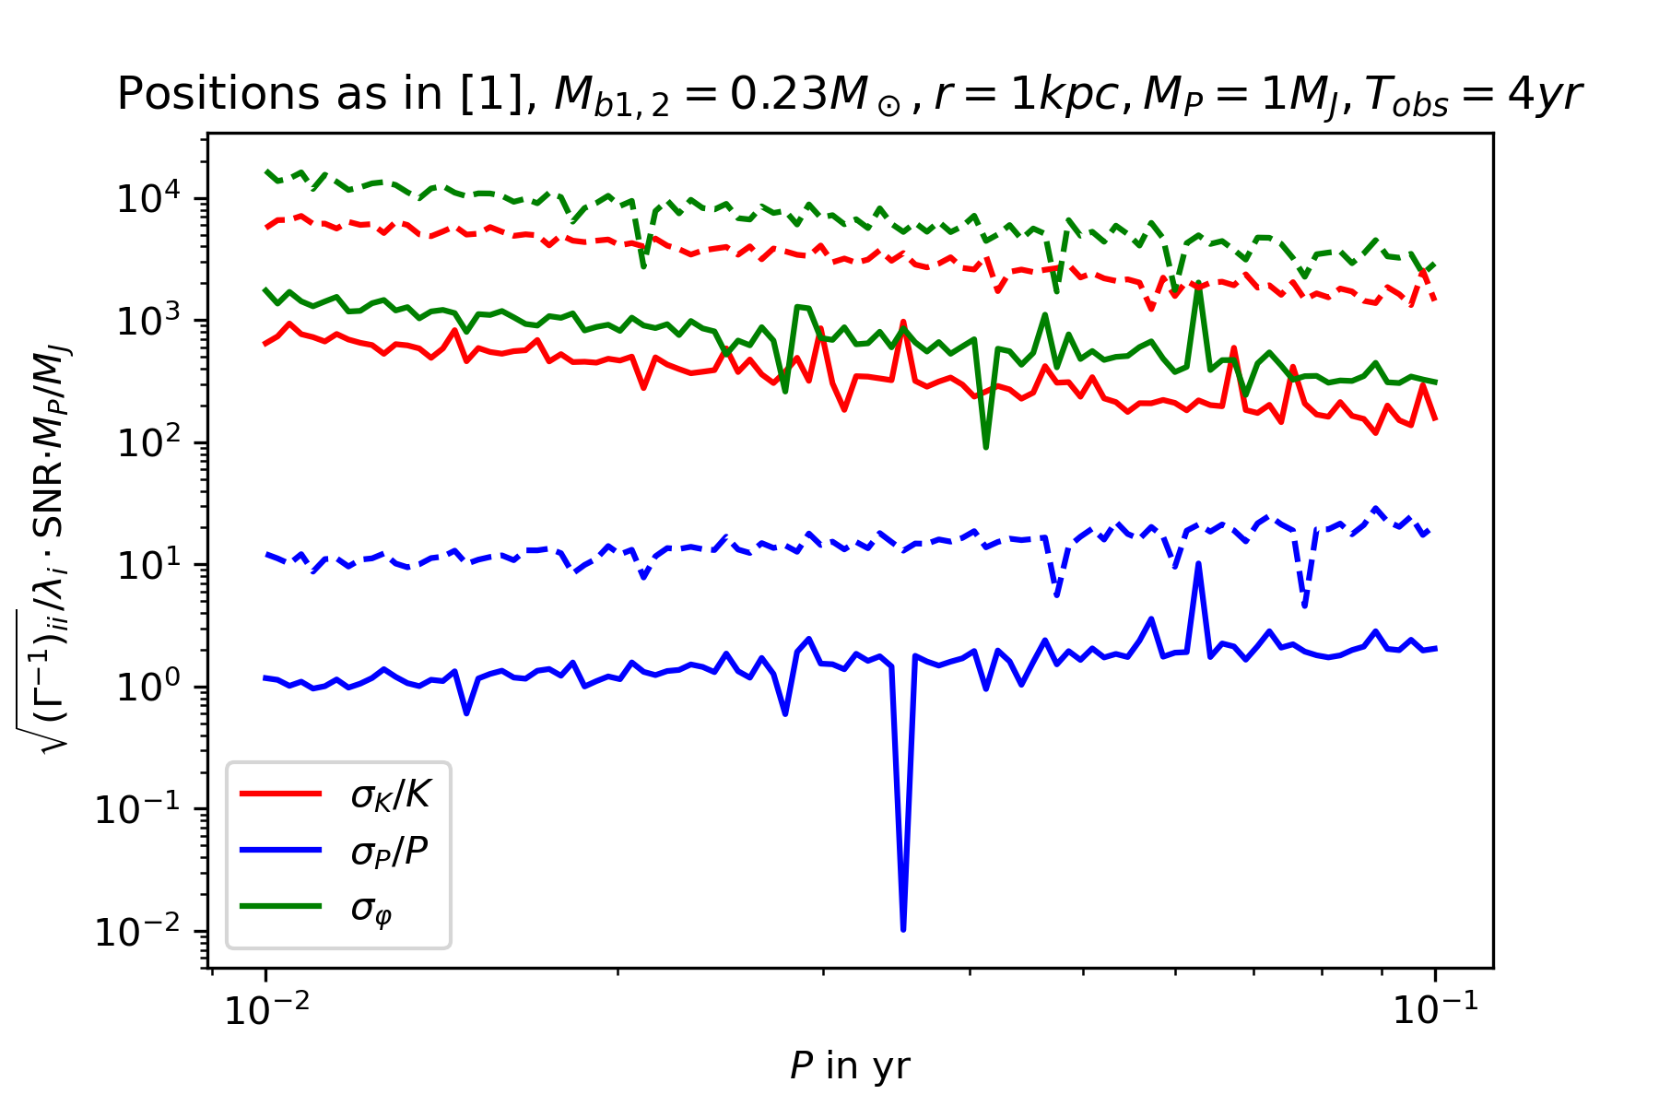
Some features get lost when zooming in

Slide 10
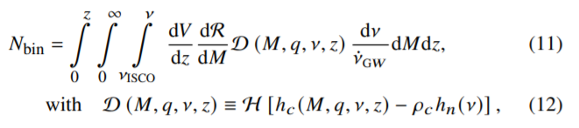
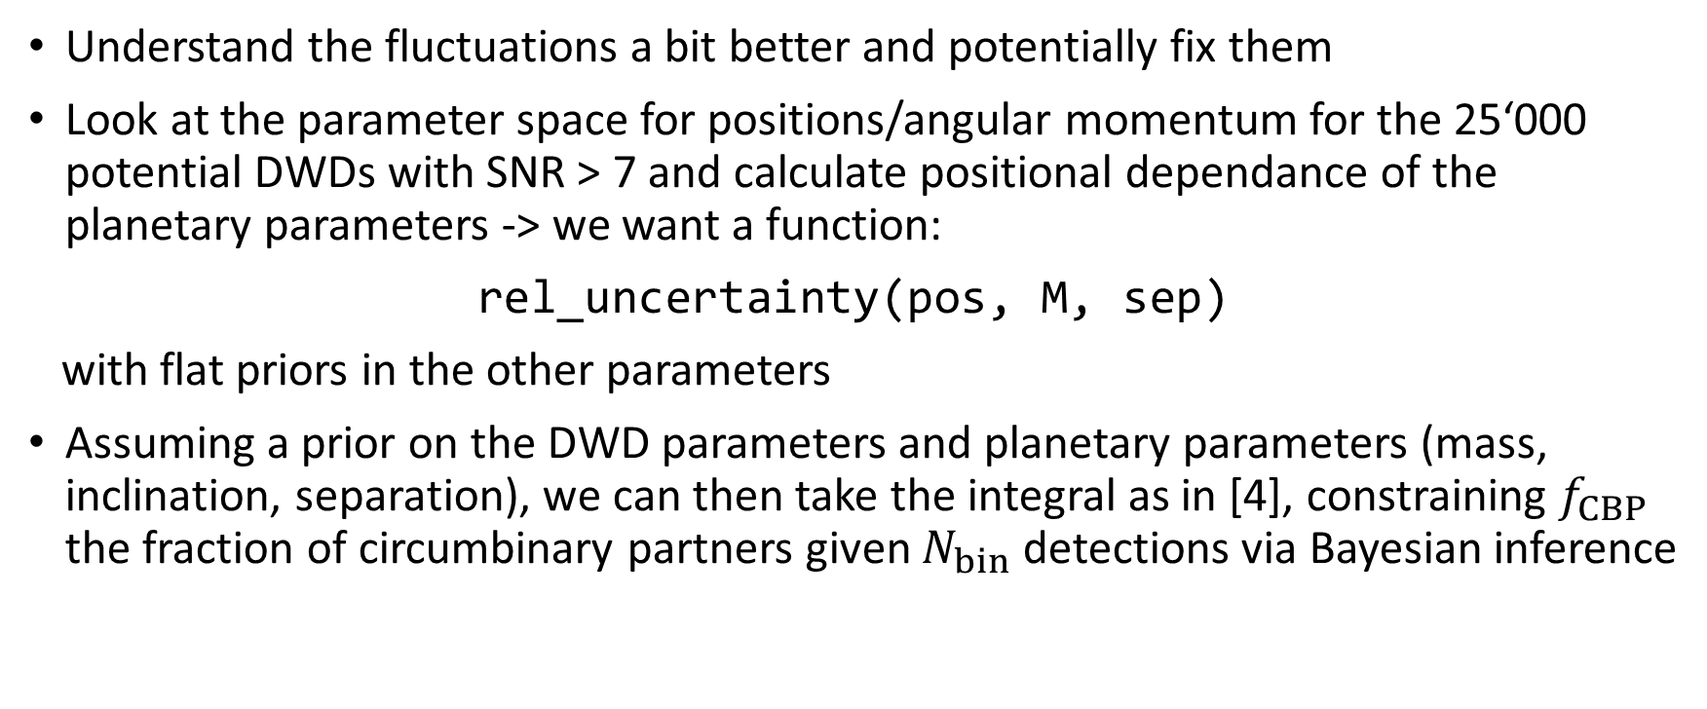
Next milestones
Understand the fluctuations a bit better and potentially fix them
Look at the parameter space for positions/angular momentum for the 25‘000 potential DWDs with SNR > 7 and calculate positional dependance of the planetary parameters -> we want a function:
rel_uncertainty(pos, M, sep)
with flat priors in the other parameters
Assuming a prior on the DWD parameters and planetary parameters (mass, inclination, separation), we can then take the integral as in [4], constraining $f_{CBP}$ the fraction of circumbinary partners given $N_{bin}$ detections via Bayesian inference

Slide 11
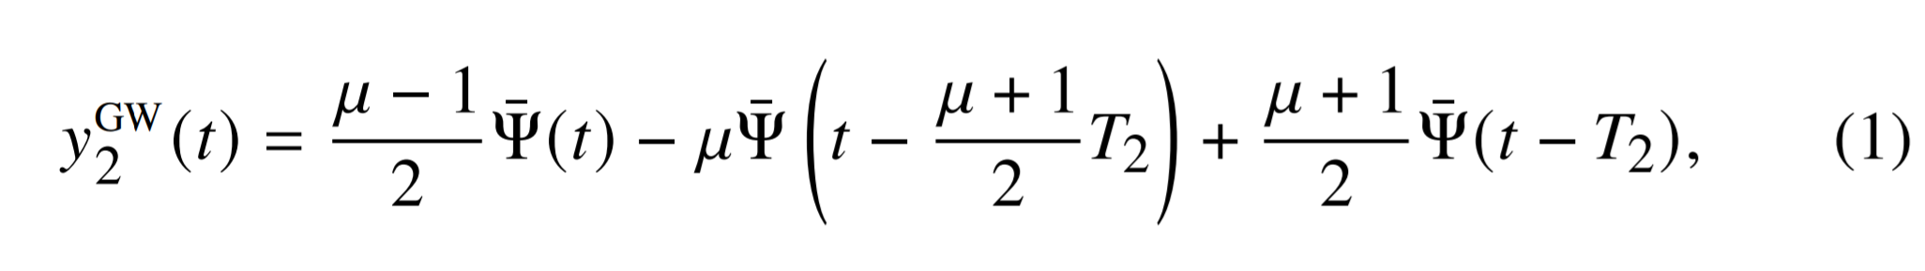
Next milestones
Then repeat the exercise with the strain and signal to noise of the IceGiant mission: to see if it could see most promising exoplanet candidates/Jupiter-like planets
Try to combine measurements of IceGiant and LISA

Slide 12
References
[1] Tamanini, N., Danielski, C. (2019). The gravitational-wave detection of exoplanets orbiting white dwarf binaries using LISA. Nat Astron 3, 858–866. https://doi.org/10.1038/s41550-019-0807-y
[2] Danielski, C., Korol, V., Tamanini, N., & Rossi, E.M. (2019). Circumbinary exoplanets and brown dwarfs with the Laser Interferometer Space Antenna. Astronomy and Astrophysics, 632.
[3] Cutler, C. (1998). Angular resolution of the LISA gravitational wave detector. Physical Review D, 57, 7089-7102.
[4] Soyuer, D., Zwick, L., D’Orazio, D., Saha, P. (2021). Searching for gravitational waves via Doppler tracking by future missions to Uranus and Neptune. MNRAS: Letters, 503, 1, L73-79. https://doi.org/10.1093/mnrasl/slab025
[5] Maggiore, M. (2008). Gravitational Waves Volume 1: Theory and Experiments. Oxford University Press

